Slide 1
6G4Z0024 Web Development Lecture 3: Cascading Style Sheets
Yanlong Zhang
Y.Zhang@mmu.ac.uk

Slide 2
Learning Objectives
Overview of inline, internal & external style sheets
Formatting text with CSS
CSS box model
Using ‘float’ for layout
Margins/borders/padding and other formatting
CSS3

Slide 3
Cascading Style Sheets
Used to style and position content of HTML documents
You can control, for example
physical layout of the page (content position, margins, padding, etc)
the formatting of text (font style, line-spacing, bold, italics, etc)
how lists are displayed (bullet/numbering style)
appearance of navigation menus
how images are displayed (position, borders, etc)

Slide 4
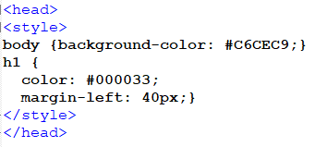
3 types of Style Sheet
Inline
The code is placed within the html body
Internal
For styling individual pages
External
Most commonly used
One external stylesheet can style many html pages

Slide 5

Style Syntax
Style declarations are in the form of a selector, a property and a value
▪
▪
▪
Selector = the element being styled (e.g. h1, a, p, etc)
Property = the attribute being styled (e.g. text colour) Value = how you want it styled (e.g. red)
selector { propertyA: valueA ;
propertyB: valueB }
NOTE!
Use American spelling for color!
h1{ font-size: 20pt ;
color: #FF3399 }

Slide 6
ids and classes
Identifiers that can be added to HTML elements
▪
▪
▪
▪
Help target styles
An id must be unique within each html document
A class can be used more than once in the same html page
Classes are useful if you have styles that you want to reuse, so tend to be used more commonly

Slide 7

Span
A span is an inline container which allows you to apply a
style, an ID or a class to a specific section of html
<p> ….. only <span style=“color: red”>£349.49</span> </p>

Slide 8
CSS Properties
There are many CSS properties
Border
Font
Text
Multi-column layout
Animation
Transform
Transition
Aural
Mainly visual, but also include aural properties for accessibility
Continues to evolve
List of CSS3 properties
Aural example:
p { voice-family: male; richness: 80; cue-before: url("beep.wav") }

Slide 9
The CSS Box Model
All HTML elements can be thought of as a rectangular box, which
can have width, height, padding, border and margin properties
Content Margin
Content Border
Content Padding
Container
text | text | text | text | text | text | text | text | text
text | text | text | text | text | text | text | text | text
text | text | text | text | text | text | text | text | text
text | text | text | text | text | text | text | text | text
text | text | text | text | text | text | text | text | text
text | text | text | text | text | text | text | text | text
Content div

Slide 10
Block-level vs inline elements
Display values
<div>
A block-level element takes up the full width of its parent or container
By default, block-level elements stack vertically
<article>
Paragraphs and headings are also block-level (<p> starts a new line)
<section>
Spans take up as much space as they need
Span is an inline element
<a> is an inline element

Slide 11
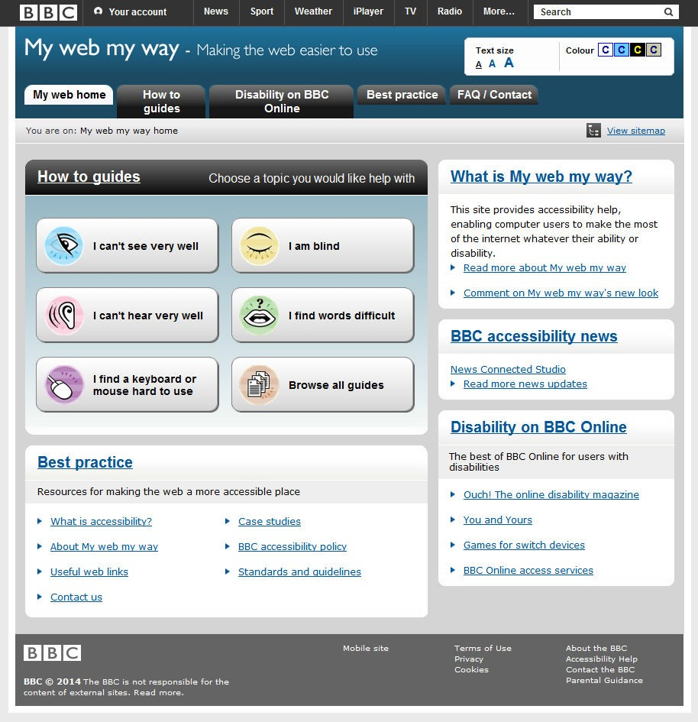
BBC Accessibility – example layout
Consider how the different layout elements are nested

Slide 12
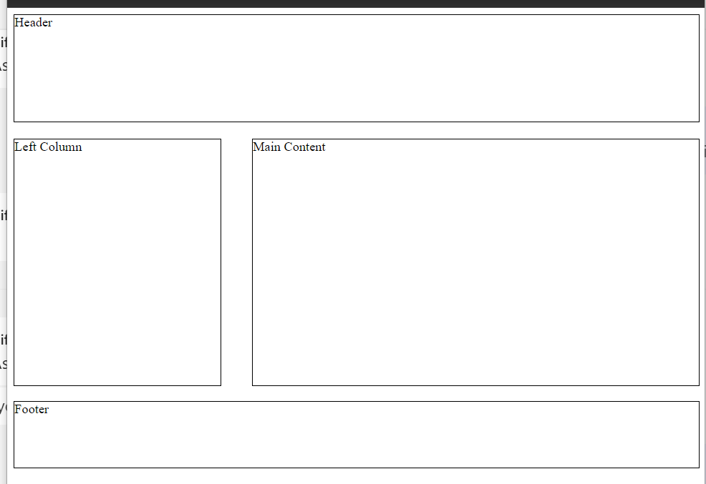
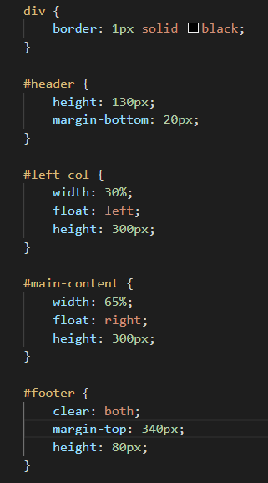
Styling the layout… floating (last week)

Slide 13
Floating and clearing elements
Floating elements is one way to break the default linear document flow
You can float left or right
Floating elements enables them to align horizontally
Content after the floated element will move out of position
Can enable layout to adapt to different viewport sizes

Slide 14
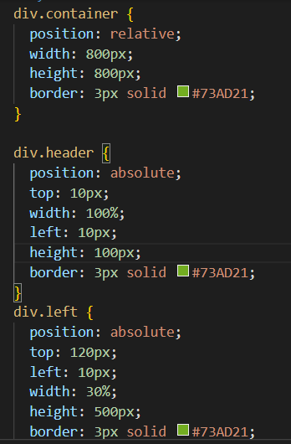
Styling the layout… nested boxes

Slide 15

margins/borders/padding shorthand
Can be defined in combination. In these examples, ‘margin’
could be replaced by ‘border-width’ or ‘padding’
margin: 25px 50px 75px 100px;
margin: 25px 50px 75px;
top margin is 25px
right and left margins are 50px
bottom margin is 75px
top margin is 25px right margin is 50px bottom margin is 75px left margin is 100px
Think clock!
margin: 25px 50px;
top and bottom margins are 25px right and left margins are 50px
margin: 25px;
all four margins are 25px

Slide 16
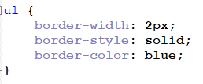

More shorthand
Can also be written as
Try out different border-style properties at w3schools.com

Slide 17
Calculating box sizes
Borders and padding are added to the dimensions of the element
Overall width of #content would be 100px + 2 borders of 10px each + padding of 20px on each side
Margins of adjacent horizontal elements can ‘collapse’
#content {width: 100px;}
#content (border: 10px}
#content {padding: 10px}
Text text text text text text
#content is actually 140px wide
#content declared as 100px wide

Slide 18
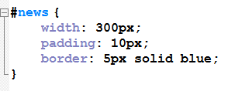
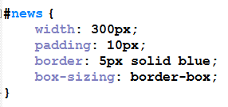
CSS box-sizing
The introduction of the ‘box-sizing’ element has enabled sizing to
be more predictable
Value of ‘border-box’ means the size you have declared for a container should include border and padding, so the area left for content resizes accordingly
Actual width = width + 2(padding + border)
Actual width = width

Slide 19
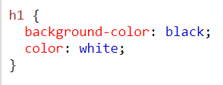
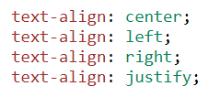




Text formatting
You can style
Colour
Background colour
Alignment
Spacing
Shadow
Try it out at W3Schools

Slide 20
Layouts
Fixed
- element specified using pixel values e.g. width: 1000px;
Layout tightly controlled/more stable
No responsiveness
Can create horizontal scroll bars on smaller display screens
Fluid/Elastic – element specified as relative to the browser window (fluid -
%) , or relative to size of the type (ems);
Adapts to different viewport sizes
Images can stretch and lose quality if you’re not careful
Responsive – use CSS features such as media queries and flex-boxes to enable content to resize, hide, or move, adapting to different size screens

Slide 21
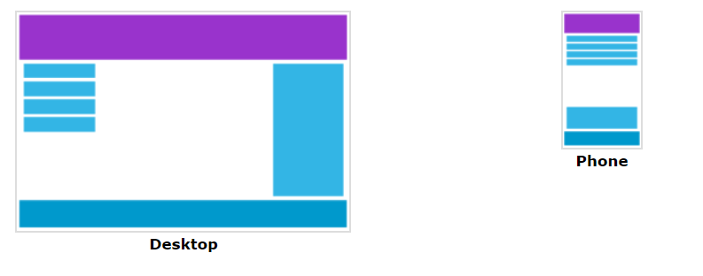
Responsiveness
Add a breaking point
@media only screen and (max-width: 600px) {
}
Try it out at W3Schools

Slide 22






CSS3 - Transforms
2D transforms can change an element’s shape, size and
position - translate, rotate, scale, skew
Use x-axis and y-axis values
Y axis
Transforms are static, and are visible as soon as the page is
opened
X axis
Rotate –
Rotates the element clockwise
Use minus value to rotate anti-clockwise
Use rotateY for rotation in 3D space
Original state
Where two values are used
Transformed state
Value 1 = X-axis
Value 2 = Y-axis

Slide 23


Transforms in use
A common use of css transforms is in photo galleries.
Animations can then be added to make the gallery interactive with hover action
Uses rotateY to position images

Slide 24
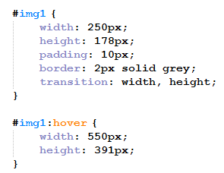
CSS Transitions
Transitions have a timing function, and a trigger
(e.g. mouse hover)
Set an initial state for the transition properties (e.g. a starting width)
In the transition statement say what properties
you want to transition
In the hover statement you add the new property
values
Transitions allow you to apply timings to transforms, so that they are triggered rather than being applied as a page is opened

Slide 25
CSS Transitions & Animations
Transitions (often with Transforms) & Animations allow you to create animation effects that can replace animated gifs and historic Flash animations
CSS3 can be combined with JavaScript
W3School: many examples with code
Animated menus
Css animations
css+JavaScript galleries

Slide 26
Text animation
Text can be animated by using transitions and animations
Allows Flash-type effects often used in advertising banners within web pages
Example of text animations
Examples of splash pages using css3
Splash-screen-design-with-css3/

Slide 27
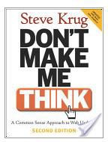

A note on usability
There are many aspects of usability – Read Steve Krug
One of the most common usability issues in coursework is poor colour combinations – get it wrong, and text is hard to read

Slide 28
Web Standards
Before web standards, developers often had to build a different version of
their site for different browsers
Different browser had different features or dealt with content in different ways
Web standards introduced rules for developers to follow, improved backwards compatibility, and improved SEO
Web standards are set by organisations like
W3C – the key standards body
WHATWG – modernised HTML
ECMA – Javascript is based on the standard for ECMAScript
Khronos – 3D graphics

Slide 29
Summary
There is a lot that you can do with CSS, from simple text formatting to animations
There is a lot to learn, but you can produce good looking websites without knowing everything
CSS will almost certainly continue to evolve

